Slide 1
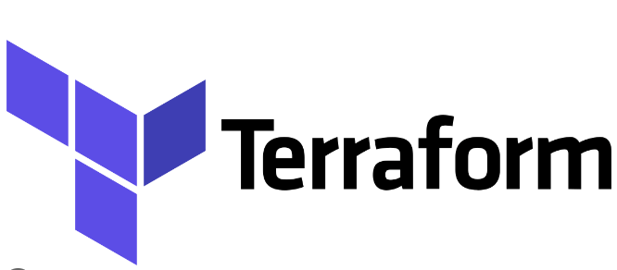

Slide 2
What is Terraform?
Terraform is an open-source infrastructure-as-code (IaC) tool developed by HashiCorp.
It allows you to define and provision infrastructure resources declaratively using a high-level configuration language.
HashiCorp, the company behind Terraform, chose Go as the primary language for developing the Terraform codebase.

Slide 3
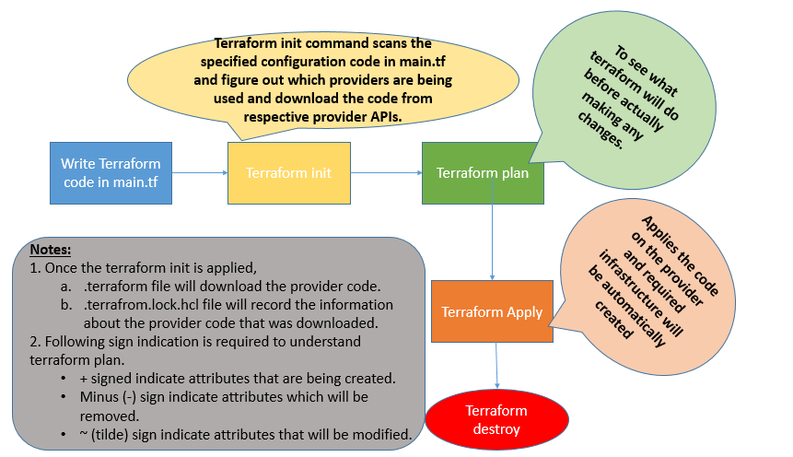
How Terraform works?

Slide 4
Let’s explore how terraform code looks like!!!
What is a provider?
A provider is a plugin that lets Terraform manage an external API.
Every resource type is implemented by a provider; without providers, Terraform can't manage any kind of infrastructure.
terraform {
required_providers {
azurerm = {
source = "hashicorp/azurerm"
version = "3.58.0"
}
}
}
provider "azurerm" {
# Configuration options

Slide 5
How to use Resources?
In Terraform, resource is a fundamental building block used to represent and manage a specific infrastructure object or entity.
resource "azurerm_resource_group" "RG" {
name = "3tierArchRG"
location = "EAST US"
}

Slide 6
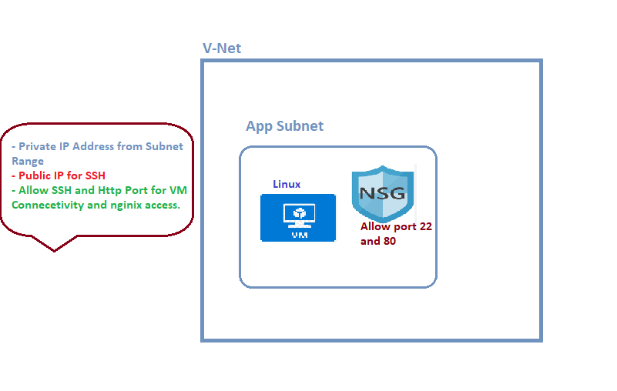
Let’s do something interesting!!!!

Slide 7
Demo Time!!!

Slide 8
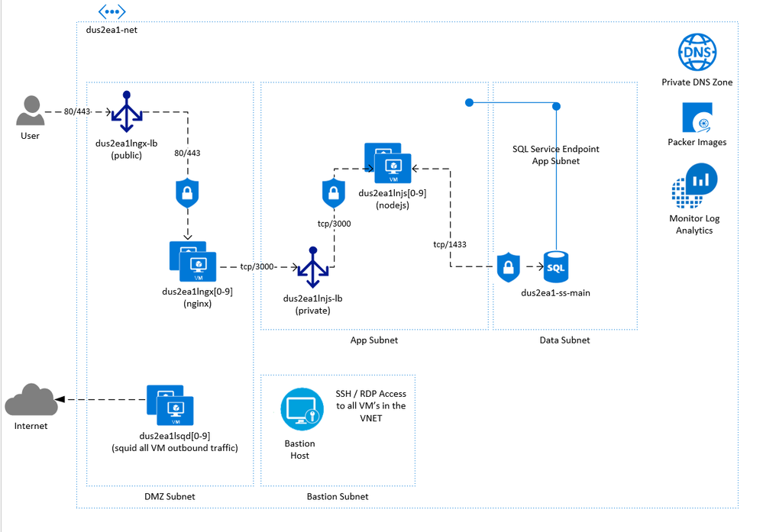
Our End Goal!!

Slide 9


